Slide 1
High-Speed VCSEL and its Application in Optical Interconnect
Speaker：Prof. Jin-Wei Shi
1
Notes:
各位口試委員大家好，我是謝幀廷，我的指導教授是許晉瑋教授，而我的論文口試題目是：High-Speed Zn-Diffusion/Oxide-Relief VCSELs at 940 nm Wavelength with Stable High-Temperature Performance for > 50 Gbit/sec Transmission
藉由鋅擴散跟氧化掏離的技術，讓940nm的VCSEL能有穩定的高溫表現，並且在高溫狀態下也能達到50G的高速傳輸

Slide 2






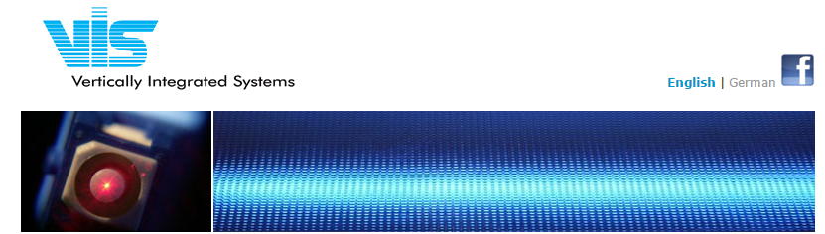
Collaborators
Prof. 陳智弘 Prof. 洪瑞華
2
Notes:
首先，我要感謝這兩年不斷給予我支持與協助的公司、學校以及我們的許團隊。

Slide 3
Outline
Why VCSEL for Short-Reach ?
The Progress in High-Speed VCSEL
Why High-Brightness/High-Speed VCSEL for 3-D sensing ?
Our Unique Device Structure and Achievements
Conclusion
3
Notes:
接下來我會先簡單的介紹一下我的研究動機，以及我們VCSEL的架構，討論元件的量測結果，最後做個總結

Slide 4
Outline
Why VCSEL for Short-Reach ?
The Progress in High-Speed VCSEL
Why High-Brightness/High-Speed VCSEL for 3-D sensing ?
Our Unique Device Structure and Achievements
Conclusion
4
Notes:
接下來我會先簡單的介紹一下我的研究動機，以及我們VCSEL的架構，討論元件的量測結果，最後做個總結

Slide 6
Changed from 2006: IBM Terabus project

Slide 7
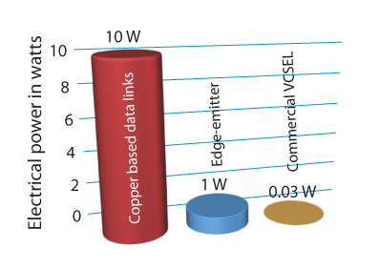

Slide 8

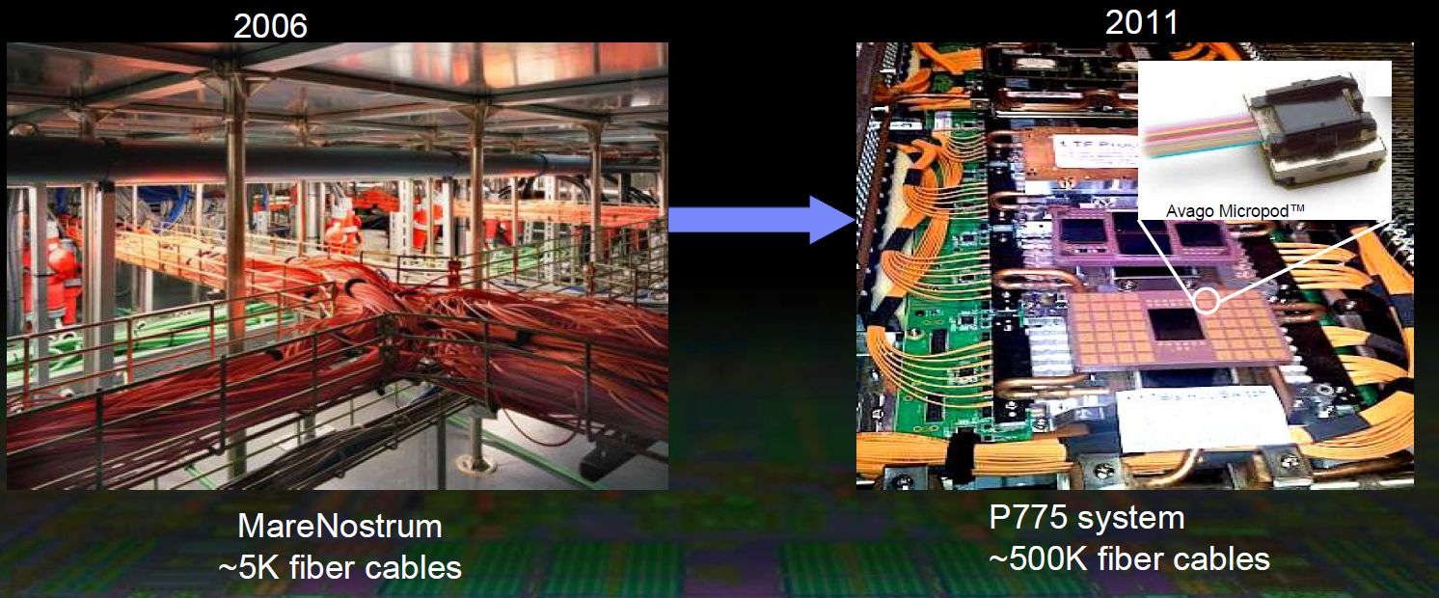
Evolution of data center
10 Gb/s
per channel
8
Notes:
下一代將會發展56g，oif提出可以實現56g的幾個的方式，那終極的話就是不用光3D堆疊，但不太可能做到因為熱的問題會很嚴重，因為56G LOSS很大，需要把optics放的離IC越近越好，如離太遠的話，我們傳輸的距離稍微遠一點的話loss就會很大，，而我們現在用到的是chip-module擦拔式的aoc，而下一代的話就是做是micropod，是將主機板上放置電光光電模組，ic一出來就走fiber不走板子，應用在光連結兩種技術分別是vcsel和pd另一種是si photonic platform，目前主流還是aoc，如果進入下一個世代50gb/s的話si photonic 將有機會打敗VCSEL ，因為si photonic 速度將會比VCSEL快且可以和cmos整合，所以我們必須提升VCSEL的速度

Slide 9
Data center VSR: Very short reach (<50 meter)

Slide 10
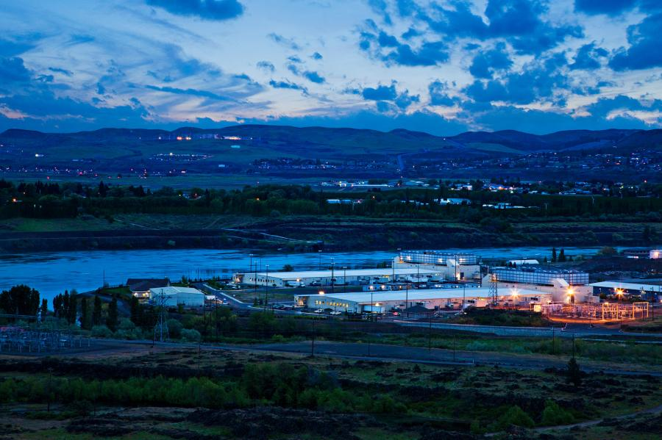
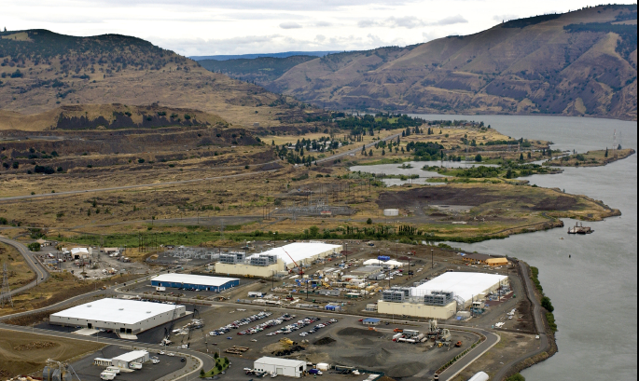
How long we need for optical interconnect ? Now, VSR (<300 m) is most popular, but….
The scale (>1km ) of Data Center become larger and larger
Locates near water for cooling !!
6
Notes:
為什麼需要很長的傳輸距離呢!? (點)
因為，大部分的datacenter 為了 cooling 方便，會將廠房建造在靠近水源河川的郊區，然而要從位於郊區的數據中心連接到大都市內的各公司、住家內部就需要較長的傳輸距離。
再來就是datacenter 內部的傳輸。

Slide 11
Data center: The new blue sea for fiber comm.

Slide 12
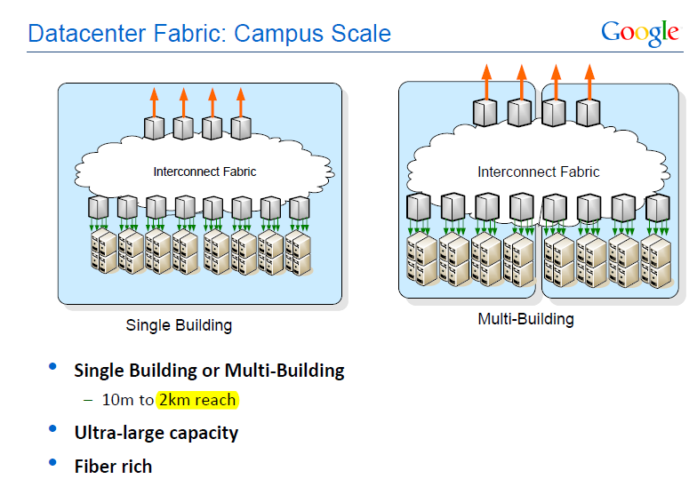
The Chance of long wavelength window at data center
LR4-Lite spec. (SMF) is happening !!
How about existed MMF ??

Slide 13
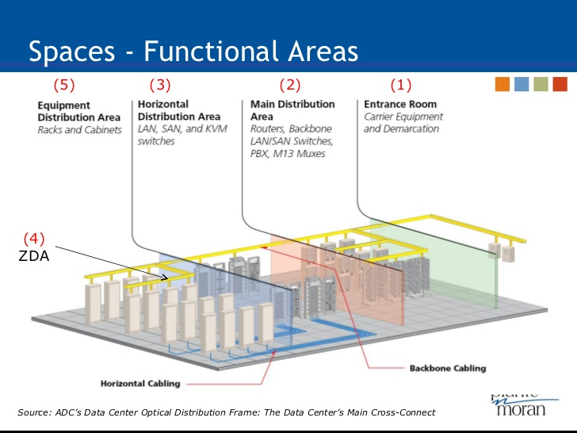
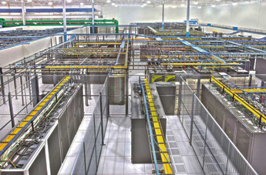
Is fiber (MMF vs. SMF) cost really an issue ???
Cost of MMF is “tens higher” than that of SMF, but MMF offers lower package cost (better alignment)
In modern data center, the length of MMF is really not a serious issue !! (MMF merges with BLDG)
No more extra stage for short to long wavelength conversions

Slide 14
Low power consumption
Longer distance
High-Power & High-Speed
Fundamental (Quasi) Single-Mode 850 nm VCSELs
High modulation speed
10
Notes:
要實現這樣的VCSEL，主要有三個重點。 低能耗、高速、以及遠距傳輸。
接下來我將會解釋，要如何達成我的元件特性需求。

Slide 15
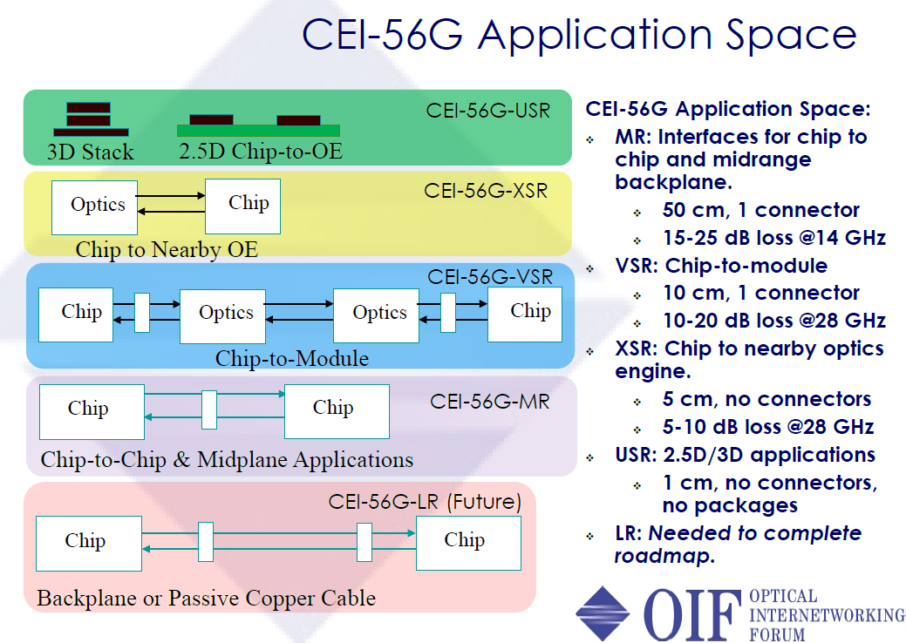
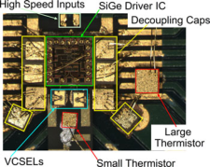
Toward 56 Gbit/sec (Inter-chip):
You need faster speed of VCSEL !!
Toward 56 Gbit/sec inter-chip OI connection
Huge loss of 56 Gbit/sec signal
Optics must be as close as possible with IC (< 5cm)
When temperature is increasing,
the VCSELs bandwidth is decreasing.
Can it still target at
56 Gbit/sec data rate?
15
Notes:
下一代的VCSEL將會朝56g的data rate發展，oif提出幾個可以實現56g的傳輸方式，那最終目標是採用3D堆疊，但技術性太高且熱的問題會很嚴重，因此目前傳輸是optical to chip的方式
56G LOSS很大，需要把optics放的離IC越近越好，但是IC會產生熱，會使得VCSEL的頻寬下降
那麼溫度升高時，VCSEL還能夠達到56G嗎?

Slide 16
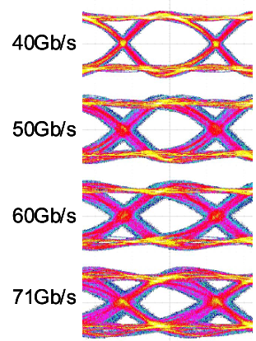
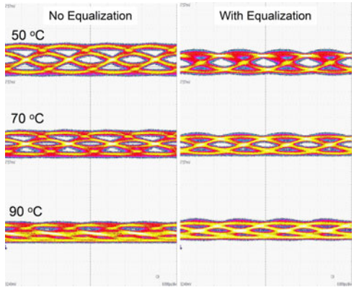
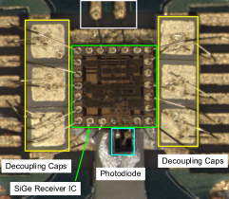

Now you need the help of IC to boost up the speed >56 Gbit/sec
50Gbit/sec
Feed Forward Equalization(FFE)
Transmitter
Receiver
High T
W/O FFE
50Gb/sec ?
Transmission data rates as high as 71Gb/sec at RT and 50Gb/sec at 90℃ when feed forward equalization(FFE) is in use.
RT
The bandwidth of VCSEL is 26GHz at RT .
Daniel M. Kuchta, Senior Member, IEEE, Alexander V. Rylyakov, Clint L. Schow, Senior Member, IEEE, Senior Member, OSA, Jonathan E. Proesel, Member, IEEE, Christian W. Baks, Petter Westbergh, Johan S. Gustavsson, and Anders Larsson, Fellow, IEEE, Fellow, A 50 Gb/s NRZ Modulated 850 nm VCSEL Transmitter Operating Error Free to 90 °C,” JOURNAL OF LIGHTWAVE TECHNOLOGY, VOL. 33, NO. 4, FEBRUARY 15, 2015
16

Slide 17
Outline
Why VCSEL for Short-Reach ?
The Progress in High-Speed VCSEL
Why High-Brightness/High-Speed VCSEL for 3-D sensing ?
Our Unique Device Structure and Achievements
Conclusion
17
Notes:
接下來我會先簡單的介紹一下我的研究動機，以及我們VCSEL的架構，討論元件的量測結果，最後做個總結

Slide 18
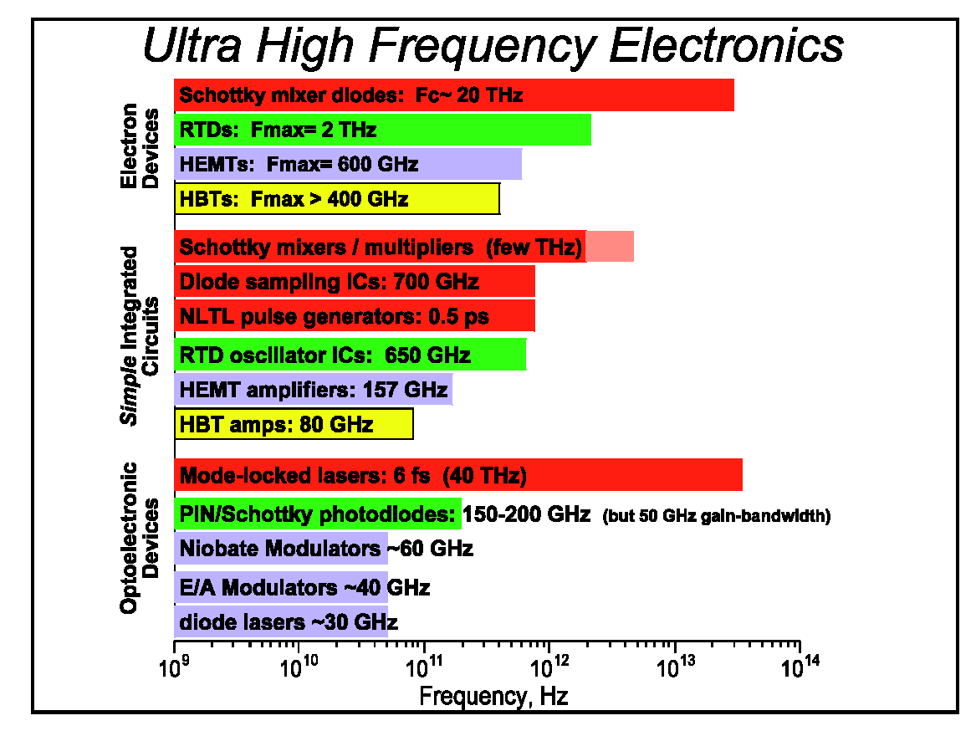
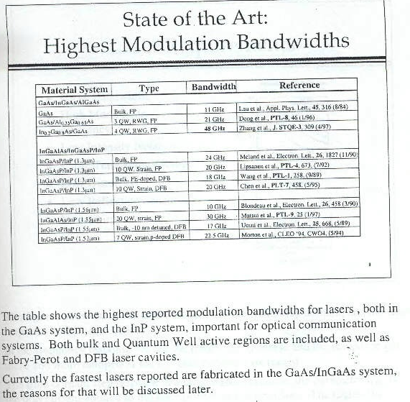
State of the Art Results
These tables are made at 1999
However, there is almost no improvement in modulation speed of SL over these 20 years ~~

Slide 19

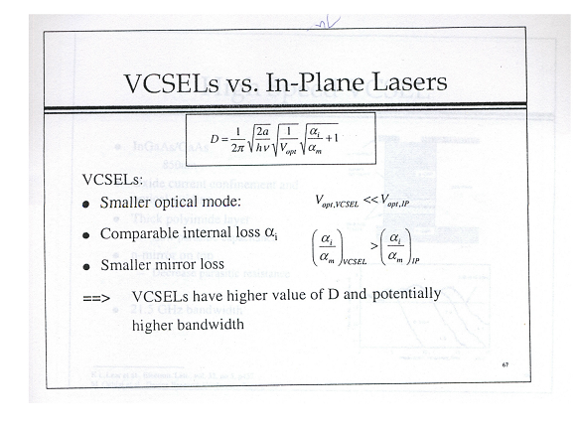
State-of-the-art high-speed VCSELs
$$f_{o}=D\sqrt{P}$$
MQWs sandwiched by oxide layers: Strong confinement !!
By courtesy of Prof. John E. Bowers
What we want is strong optical confinement and smallest VCSEL cavity with large differential gain (a) !!
By courtesy of Dr. Daniel M. Kuchta

Slide 22
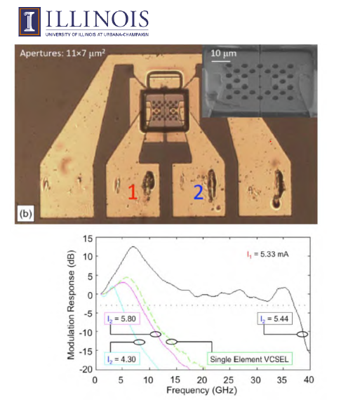
Toward higher Speed : Coupled Cavity (photon-photon resonance !!)
By courtesy of Dr. Daniel M. Kuchta
High-T operations ??
More than 10 dB resonance in measured O-E frequency response: Eye patterns ?
3dB Bandwidth near 37 GHz !! But only happens at special combination of bias currents

Slide 23
Toward higher Speed : Coupled Cavity (photon-photon resonance !!)
By courtesy of Dr. Daniel M. Kuchta
High-T operations ??
Large Signal Transmission (>50 Gbps) ?

Slide 24
Outline
Why VCSEL for Short-Reach ?
The Progress in High-Speed VCSEL
Why High-Brightness/High-Speed VCSEL for 3-D sensing ?
Our Unique Device Structure and Achievements
Conclusion
24
Notes:
接下來我會先簡單的介紹一下我的研究動機，以及我們VCSEL的架構，討論元件的量測結果，最後做個總結

Slide 25

Motivation
High-brightness VCSEL light sources
Autonomous lidar: short range: 10-50m
5
Optics and photonic news, Jan 2018

Slide 26

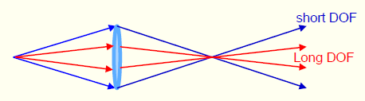
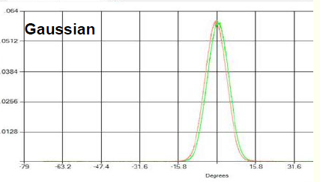
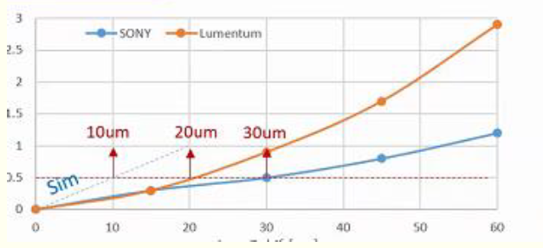
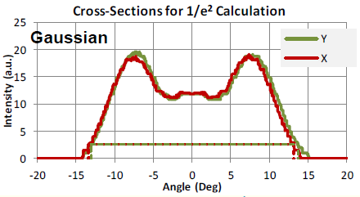
Smaller divergence angle leads to-
Longer Depth of field(DOF)
Bigger dot size around focus point
Can further enhance working distance: Tens to hundred of meters
Clandestine surveillance cameras (standoff range between 5 ~100 meters)
6
Himax technologies co. ltd.

Slide 27
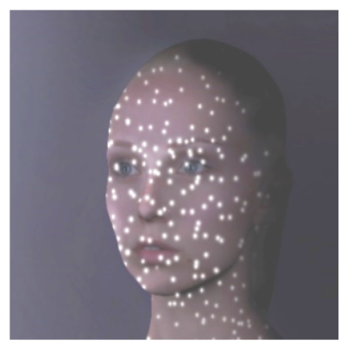
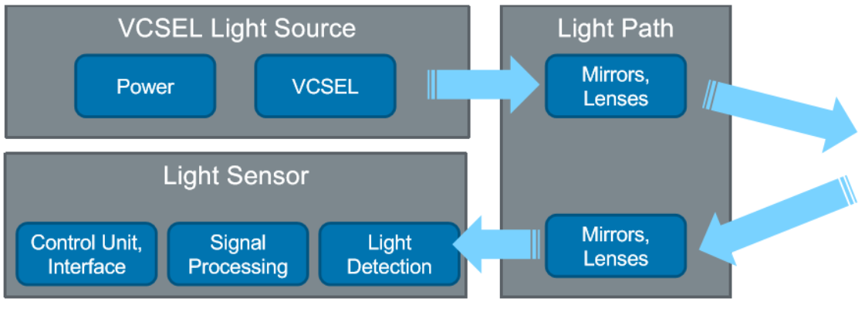
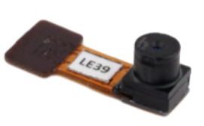
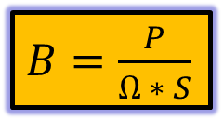
Why high brightness (narrow divergence angle and high power) VCSEL ?
VCSEL Diffusor
High power and low divergence angle
Enhance the brightness of each spot
$B=\frac{P}{Ω ∗ S}$
where P- output power of emitted light beam
Ω-solid angle formed by emitted light beam
S-area of emission of emitted light beam
Tailored VCSEL Illumination with optical sensors which enables end to end platform
7
ams.com

Slide 28
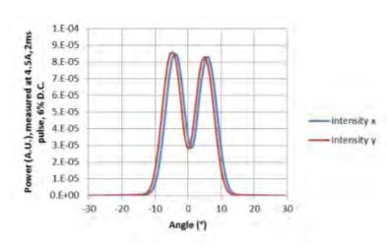
Simplest way to increase brightness of VCSEL (Increasing Power)
Power
Large Area
Multimode
High power but low brightness
II-VI.com 940nm multimode high power VCSEL Array
8
Notes:
我們可以想像一下，若在小面積的時候要做成ｓｉｎｇｌｅ ｍｏｄｅ其實沒有這麼困難，但是面積變大之後雖然ｐｏｗｅｒ會上升，但容易形成ｍｕｌｔｉ ｍｏｄｅ這是我們不樂見的

Slide 29
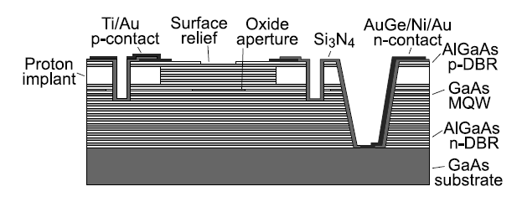
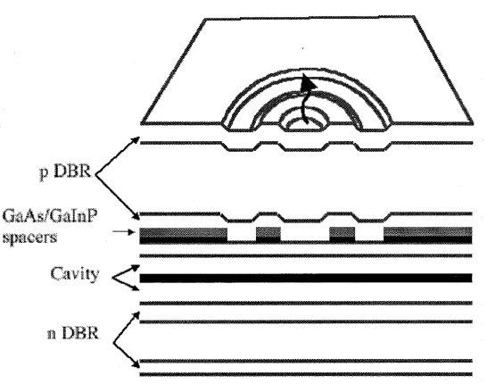
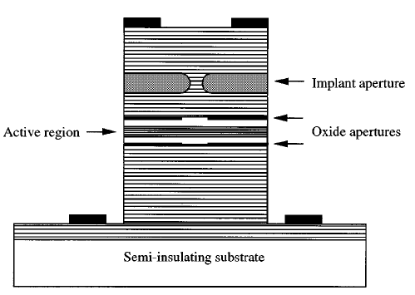
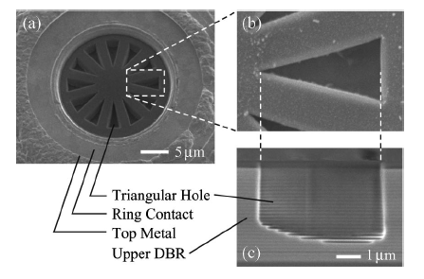
How to increase brightness of VCSEL: Single-Mode VCSEL
Complex epi. growth
Enhances
intra-cavity loss
(a) Surface relief
How to achieve
large-area single-mode lasing without increasing loss?
Accurate etch depth and arrange
(c) Anti-resonant reflecting optical waveguide-type
(d) Implant structure
(b) Triangular holey
Resistance
(a) Å. Haglund, J. S. Gustavsson, J. Vukuˇsic´, P. Modh, Member, IEEE, and A. Larsson, Member, IEEE, IEEE PHOTONICS TECHNOLOGY LETTERS, VOL. 16, NO. 2, FEBRUARY 2004.
(b) Akio Furukawa, Satoshi Sasaki, Mitsunari Hoshi, Atsushi Matsuzono, Kosuke Moritoh , Toshihiko Baba, APPLIED PHYSICS LETTERS ,VOLUME 85, NUMBER 22, 29 NOVEMBER 2004.
(c) Delai Zhou, Member IEEE, and Luke J. Mawst, Senior Member IEEE, IEEE JOURNAL OF QUANTUM ELECTRONICS, VOL. 38, NO. 12, DECEMBER 2002.
(d) E. W. Young, K. D. Choquette, S. L. Chuang, K. M. Geib, A. J. Fischer, and A. A. Allerman,IEEE Photon. Technol. Lett., vol. 13, pp. 927-929, Sep., 2001.
9
Notes:
如何去提升在單模態VCSEL的亮度呢？
已經有許多研究團隊提出，例如：表面浮雕(surface relief)的方法來製作單模態VCSEL，及三角結構環狀，但製作方法非常不容易。
當然也有利用離子佈值的方式，(按)不過會讓元件電阻上升。
(按)而上述這些製程方式都是複雜的!!

Slide 30
Outline
Why VCSEL for Short-Reach ?
The Progress in High-Speed VCSEL
Why High-Brightness/High-Speed VCSEL for 3-D sensing ?
Our Unique Device Structure and Achievements
Conclusion
30
Notes:
接下來我會先簡單的介紹一下我的研究動機，以及我們VCSEL的架構，討論元件的量測結果，最後做個總結

Slide 31
Achievements 1
Ultra-Fast VCSEL

Slide 32
How to increase the speed of VCSELs
Enhance differential gain
Reduction of RC delay
High speed 850-940nm VCSELs
32
Notes:
為了增加VCSEL的3dB頻寬，我們實驗室採用了2個要點：增加differential gain以及降低RC delay，首先先討論如何增加differential gain

Slide 33

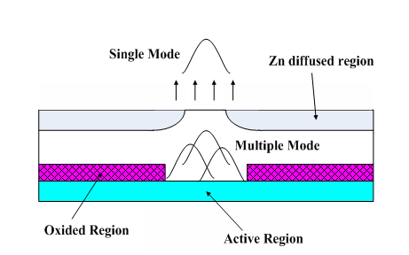
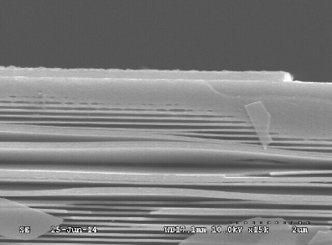
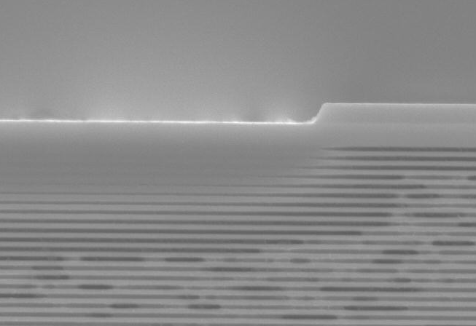
Zinc Diffusion
Oxide region
Zinc diffusion region
Distributed Bragg Reflector
n
(Reflectivity)
Zinc diffusion
R ( series resistance)
Disorder
W_{Z}
W_{O}
High quality Si3N4
Bad film
Good film
P-DBR
P-DBR
33
Notes:
我們使用鋅擴散製程，鋅擴散可以將一層一層高反射率的DBR打亂，使反射率下降，因而降低電阻值，除此之外，鋅擴散還有抑制膜態的功用，使膜態乾淨，甚至達到SM的效果。
而鋅擴散製程有一個非常關鍵的需求，他需要品質非常好的SiN當作hard mask，如左下左邊這張圖，膜的品質不夠好，則會有嚴重的鳥嘴效應，右邊才是理想的擴散結果。

Slide 34
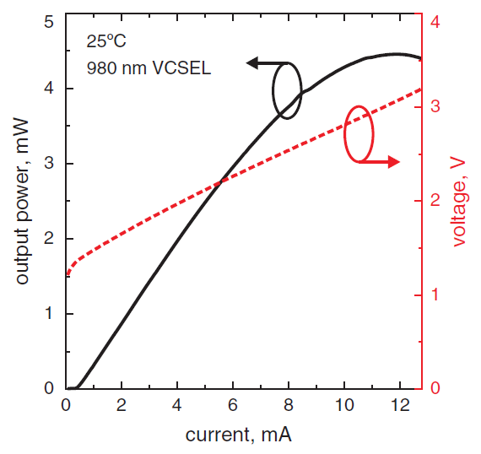
Reduction of resistance
25°C
940 nm VCSEL
Zn diffusion and adding current spreading layer can efficiently decrease the resistance of VCSELs.
Wo:5~6μm
Ith:0.4mA
Pmax:1.4mW
Current spreading:0.3μm
Zn diffusion:1μm
Wo:4.5~5μm
Ith:0.42mA
Pmax:4.46mW
R=140Ω
at 11.9mA
R=35Ω
at 10mA
Our VCSEL
P. Moser, et al., Error-free 46 Gbit/s operation of oxideconfined 980 nm VCSELs at 85°C, Sept., 2014
34
Notes:
這是我們與Bimberg團隊的元件比較，我們940nm波段的VCSEL，和他們980nm 波段的VCSEL同樣都是氧化孔徑約5um，Ith約0.4mA，他們電阻值約140歐姆，而我們的阻值才約35歐姆 遠小於140歐姆 因此證實藉由鋅擴散和current spreading 是真的可以有效的降低電阻

Slide 35
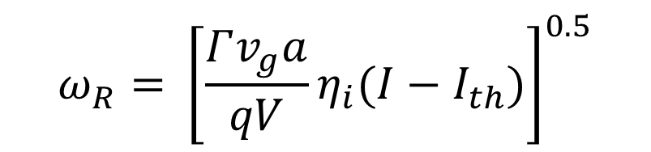
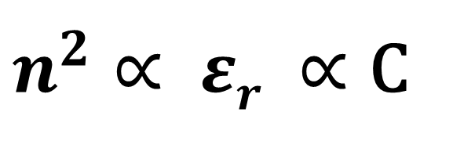
How to reduce parasitic capacitance ?
Oxide relief
Zinc diffusion
Oxide-aperture
Bandwidth
Oxide layer
Current density
MQW
Due to the fact that the refractive index of air
is much smaller than that of the AlxO1−x layer,
there is a further reduction in the parasitic
capacitance of the oxide-relief device.
Reliability may be a problem !!
$$ω_{R}={ \left[\frac{Γv_{g}a}{qV}η_{i}(I−I_{th})\right]}^{0.5}$$
$n^{2}∝ εr ∝$ C
35
Notes:
這是我們VCSEL簡單的示意圖，如果要提升元件速度，最直接的方式就是將氧化孔徑做小，由這個公式可以看到，氧化孔徑變小，confine factor就會上升，連帶的共振頻率也會跟著上升，同時縮小孔徑也會造成current density上升，導致熱效應會更嚴重，那麼reliability可能會是個問題，加上氧化後，氧化層會有些許defect，也會影響可靠度，因此為了提高reliability，並且使元件維持高速，我們使用了氧化掏離的技術，去除defect，並且將氧化層變成空氣，由於空氣的折射係數比氧化層要小，所以氧化掏離後能夠有效地降低寄生電容。
電容攻勢

Slide 36
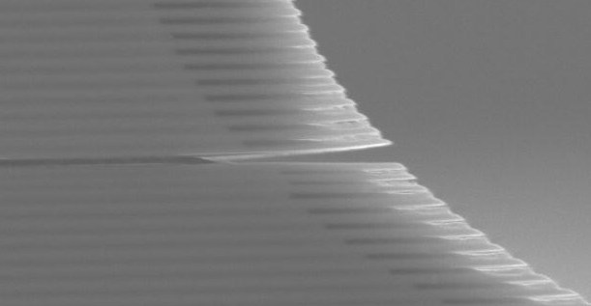
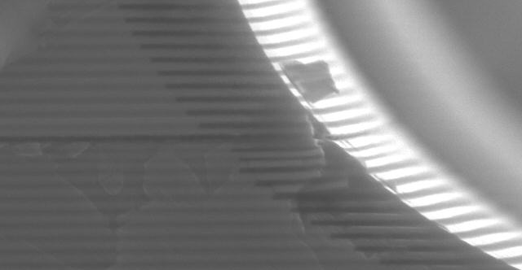
Our Approach: Oxide-relief
With oxide-relief
Without oxide-relief
AlO_{x}
AlO_{x} has been removed.
Reliability will increase.
Speed will increase.
AlGaAs

Slide 37

With vs. without oxide-relief
Oxide-relief structure usually has slightly better L-I and V-I performance than without oxide-relief structure.
Both of them exhibits similar threshold current and maximum output power.
W_{Z} /W_{O} /d = 5.0/5.5/1.0 μm

Slide 38
With vs. Without Oxide-relief
Oxide-relief process will not degrade the DC characteristics, and can further improve the speed performance of the devices significantly.
Bandwidth improvement effect can be attributed to reduction of the parasitic capacitance.
W_{Z} /W_{O} /d = 5.0/5.5/1.0 μm

Slide 39
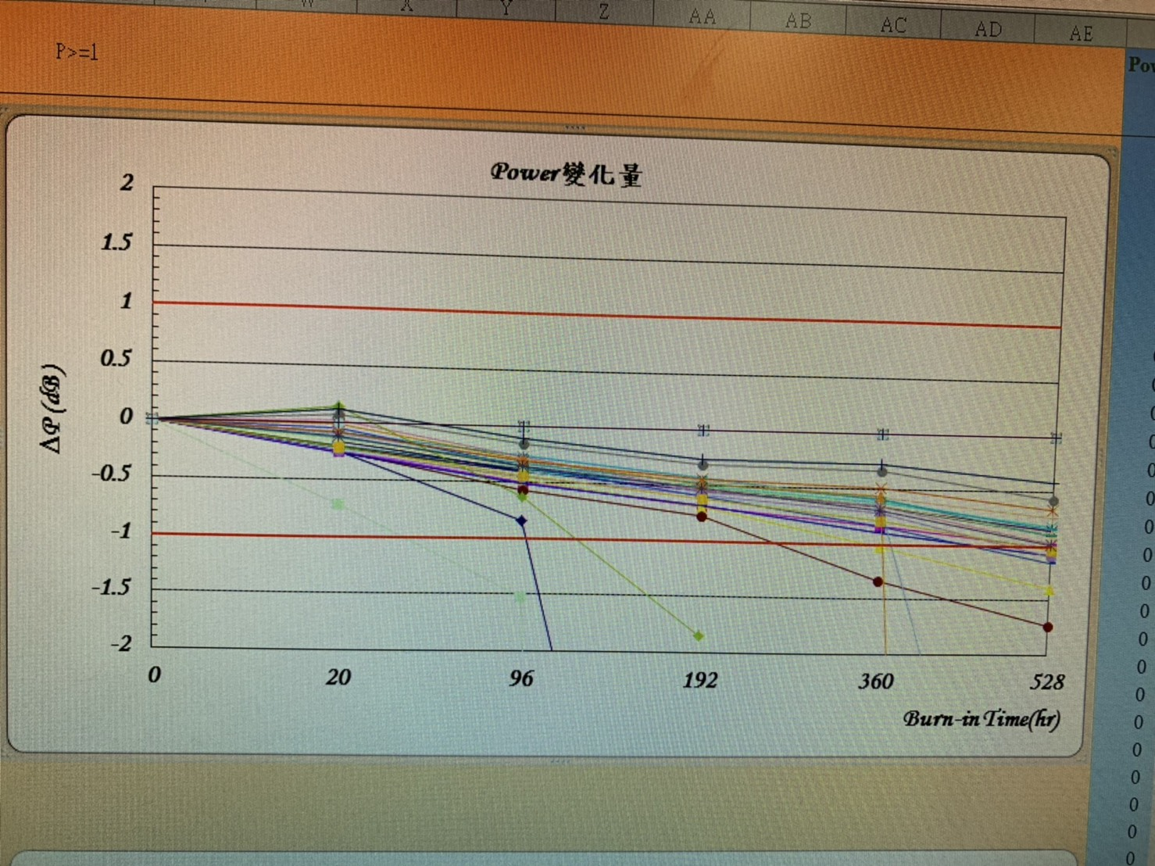
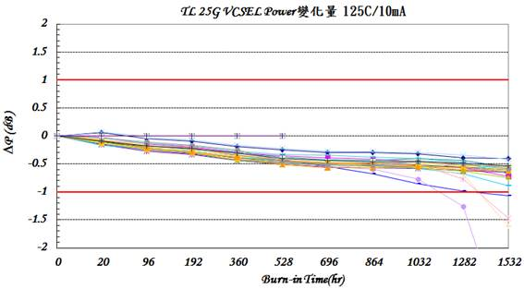
Reliability Improvements
Under 125°C and 10 mA operation.
Without oxide-relief
With oxide-relief

Slide 40
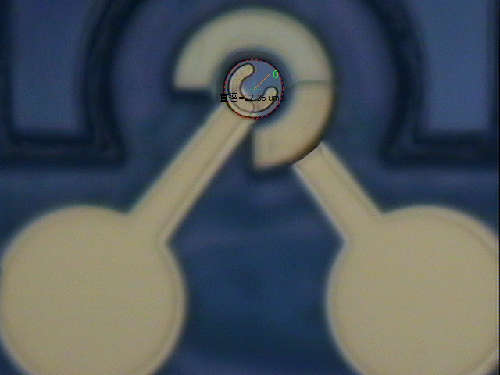
940 nm VCSEL Structure
Pad
W_{Z}
P contact
R_{pad}
R_{c}
C_{p}
Zn diffusion
Current
spreading
C_{o}
R_{a}
d
Oxide relief
L_{pad}
0.5 λ Cavity,
InGaAs/AlGaAs MQW
SiO₂
Undoped layer
W_{O}
N contact
BCB
Undoped layer
GaAs Substrate
40
Notes:
左邊是我們的VCSEL結構圖，藉由鋅擴散以及current spreading降低電阻，氧化層進行掏離降低電容並提高可靠度，QW則是設計成strained MQW來增加增益以及改善熱效應。右邊是我們元件的俯視圖。

Slide 41
Different Oxide aperture size
2~3 um
4~5 um
7~8 um
Excellent High-T Performances for all three different aperture sizes !!
41
Notes:
電阻方面有無掏離也沒有太大影響，阻值都在約30歐姆左右

Slide 42
Comparison 3 um 6 um 9 um oxide aperture
4mA
7mA
14mA
3mA
4mA
7mA
3mA
5mA
11mA
(c)
(a)
Device C (9um)
Device A (3um)
(b)
Device B (6um)
Close to 50 Ohm matching
42
Notes:
但是S11可以明顯看出 有掏離的元件，動態電阻較小，證實了氧化掏離可以使電容下降

Slide 43
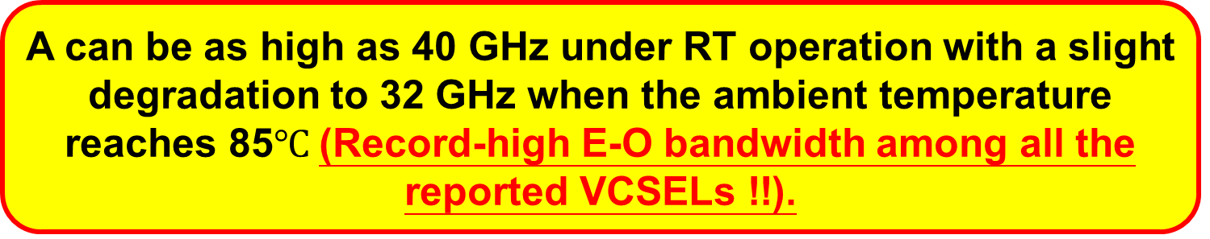
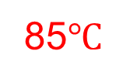
High-speed E-O performance
2~3um
Room temperature
85$℃$
A can be as high as 40 GHz under RT operation with a slight degradation to 32 GHz when the ambient temperature reaches 85$℃$(Record-high E-O bandwidth among all the reported VCSELs !!).

Slide 44
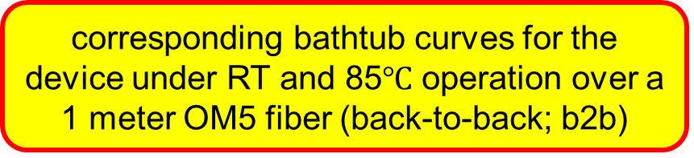
The 50 and 60 Gbit/sec on-off keying transmission
50 Gbit/sec bit-error-free (BER < 1×10-12) transmission can be successfully achieved from RT to 85℃ operations without using any pre-emphasis or equalization techniques.
corresponding bathtub curves for the device under RT and 85$℃$ operation over a 1 meter OM5 fiber (back-to-back; b2b)
The maximum error-free data rate can be boosted up to 60 Gbit/sec under RT operation
44

Slide 45

B2B and 100 meter OM5 fiber transmission result with FFE
In order to improve the 100 meter transmission result,invariant 50 Gbps transmission performance from RT to 85 $℃$ operation can be achieved with standard 5 tap FFE (Feed-Forward Equalization )

Slide 46
Achievements 2
High-Temperature and High-Speed VCSELs (Novel MQWs)

Slide 50
State-of-the-art super high-T/high-speed VCSEL !!
No DSP and no pre-emphasis !!

Slide 51
Achievements 2
High-Brightness and High-Speed VCSELs Array

Slide 52
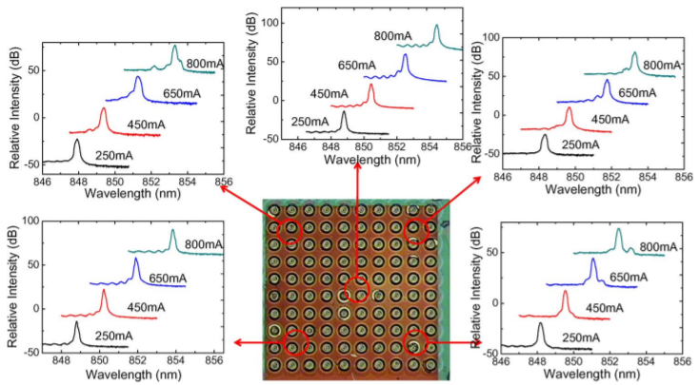
Our approach to achieve large area single mode array: Using Zn–diffusion technique
Wz
Zn-diffusion
intra-cavity loss is necessary
Optical field
Optical Power
Oxide layer
Loss
QW
I_{th}
Electric field
Wo
J.W.-Shi et.al, Single mode VCSEL array with high power and narrow far-field divergence angle, IEEE phot. J., 2013
12
Notes:
鋅擴散的VCSEL，(按)會因為水氧孔徑大於鋅擴散孔徑，使光場看到更多的衰減，來達到單模態的表現。
(按)下圖可看到兩張L-I曲線，右邊因為水氧孔徑較大使得臨限電流較大，且因水氧孔徑大於鋅擴散，造成power損耗。
(按)但同時也使得頻譜模態形成了Single-mode。
(按)然而，這個方法會使得水氧孔徑大於發光孔徑，這與降低spatial hole burning效應有所違背，(按)那要如何解決此現象呢？

Slide 54
Device structure
Lattice constant of Cu lattice constant of GaAs
~570 emitters
Strain
Optical Waveguide
Top-View
Conceptual Cross-sectional view
16

Slide 55
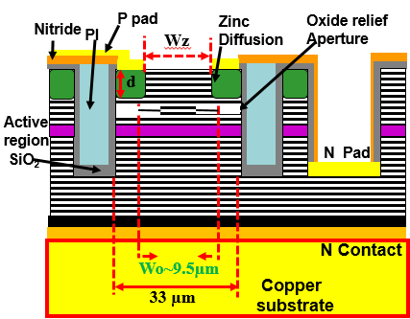
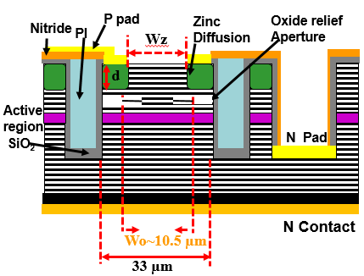
Array(L-I)
CW
Strain
We achieved high power, single-mode large-area array only by strain without enhancing intra-cavity loss
Ith: 0.3A
Wo/Wz/d-9.5/7.5/1.7µm
Average bias threshold current per unit device ~0.8 mA
PW
Ith: 1.3mA for single reference device
<
Average bias threshold current per unit device ~0.7 mA
Ith: 0.45 vs 0.38A
SD
Ith: 1.3mA
19

Slide 56
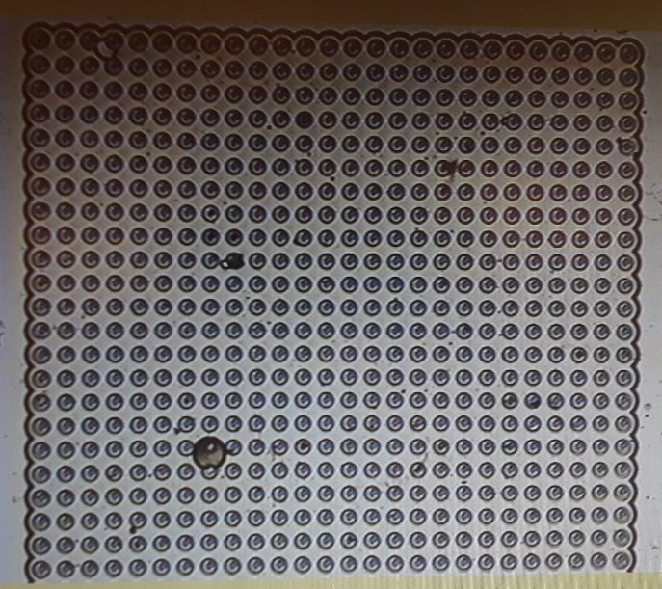
Optical spectrum(Before Electroplating)
Quasi-single mode at every bias currents(Pulse operation)
B
C
A
D
E
Without using electroplating
20

Slide 57
Optical spectrum
(After Electroplating)
Optical spectrum switches to highly single mode at every bias currents(Pulse operation) without incorporating extra intra-cavity loss
Strain
We achieved highly single-mode large-area array only by strain (electroplating) without enhancing intra-cavity loss
With electroplating
SD W/O Electroplating
Significant blue shift due to tensile strain resulting from backside electroplating
red shift is more due to difference in thermal expansion coefficient of remaining GaAs and electroplated substrate ten
21

Slide 58
Far-field pattern
Shallow dip(<20%) 1/e2:<12 degree
Perfectly Gaussian
1/e2:<10 degree
Without electroplating
With electroplating
Strain
22

Slide 59
Array with electroplating exhibits polarization suppression ratio ~9dB
Polarization
Combining low loss Zn-diffusion aperture and tensile strain resulting from electroplating leads to low intra-cavity loss
90⁰
54.7⁰
Suppressing higher order modes thereby enhancing selectivity of fundamental mode
0⁰
25

Slide 60
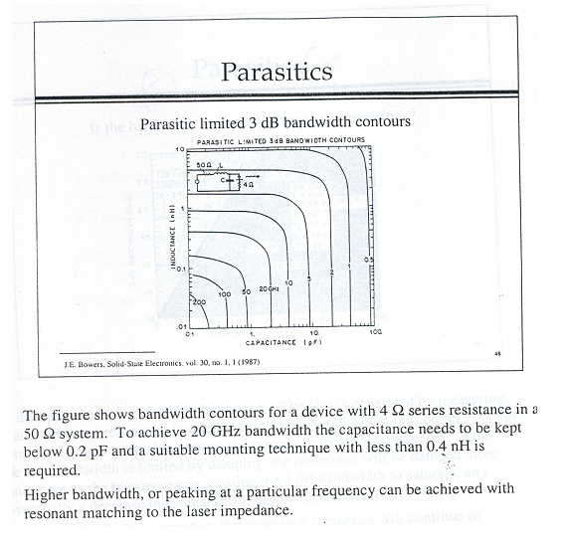

Parasitic –Device structure with low parasitics
With a Larger Capacitance (area), smaller inductance is required

Slide 61
Dynamic Responses of our high-brightness VCSEL array with oxide-relief (2W@3A)
“Ten times” faster (0.1 vs. 1 ns) than that of commercial available high-power 940nm VCSEL array (the same power level) !!

Slide 62
Outline
Why VCSEL for Short-Reach ?
The Progress in High-Speed VCSEL
Why High-Brightness/High-Speed VCSEL for 3-D sensing ?
Our Unique Device Structure and Achievements
Conclusion
62
Notes:
接下來我會先簡單的介紹一下我的研究動機，以及我們VCSEL的架構，討論元件的量測結果，最後做個總結

Slide 63
Conclusion
We demonstrate a novel 940 nm VCSEL for the application of short wavelength division multiplexing (SWDM) over MMF for a 40 and 32 GHz 3-dB E-O bandwidth under RT and 85°C operations by utilizing oxide-relief and Zn-diffsuion apertures.
54 Gbit/sec error-free transmision over 1 km OM4 fiber at 850 nm wavelength
25.78 Gbit/sec 1.7 km MMF error-free transmission at 85 degree C can be achieved
By applying Zn-diffusion/oxide-relief apertures and package induced strain, high-brightness 940 nm VCSEL array with 10º (1/e^2) far-field angle, 2W@3A, 0.1 ns rise time has been demonstrated.
63
Notes:
我們的並聯VCSEL陣列，使用了鋅擴散技術及氧化掏離技術，同時可以達到增強輸出光功率，即在其最大調製速度上並沒有劣化的結果。
當我們使用並聯的陣列進行傳輸，也能夠很清楚的看到他在較高的data rate 46GHz上的增強

Slide 64

Thank you

Slide 65


Double-crystal x-ray measurement
We observe 0.71% thinning of epitaxial layers after electroplating process
Diffraction peak of array with electroplating shifts from 31.43 degree to 31.68
lattice constant of our array before ($5.42×{10}^{−3}$) and after ($−1.69×{10}^{−3}$) electroplating
Internal strain of Array with electroplating shifts from compressive to tensile
a- lattice constant of bulk GaAs wafer
Δa-change in GaAs lattice constant in vertical direction
θl, θs- measured diffraction angle of epi-layer and substrate
${(\frac{∆a}{a})}_{⊥}= \frac{sinθ_{s}}{sinθ_{l}}−1$
23

Slide 66
Simulated VCSEL reflectivity spectra
Using ABCD matrix before and after electroplating process
Etalon dip(lasing wavelength) shifts to 932 nm from 938 nm
Consistent to our optical spectra
24

